Slide 1

Google Polymer
An introduction to Google Polymer
Notes:
In introduction to Google Polymer.
March 2018
- by Gerard Payne

Slide 2

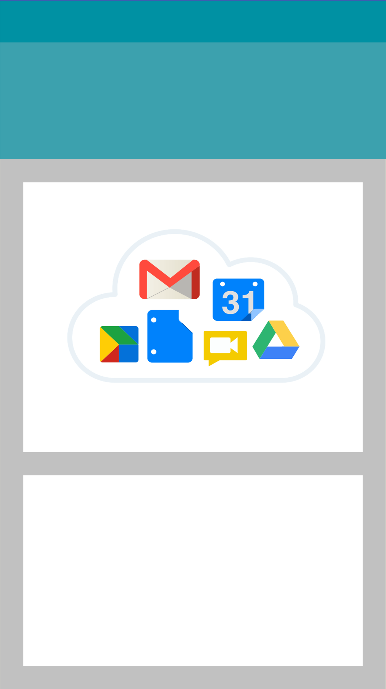
Google Polymer
W3c Web Components
+
Google Material Design
Custom Element API - HTML Templates - HTML Imports - Shadow DOM
Notes:
Google Polymer is essentially a combination of the new(ish) W3c Web components specification
https://developer.mozilla.org/en-US/docs/Web/Web_Components
and Google's design specification “Material design”
https://material.io/

Slide 3
Polymer
Make your own custom element
http://github.com/gerard-payne/polymer-demo
Notes:
Welcome back, for the second part of our session we are going to make a simple component.
To begin we will need to download some source files to give us the tools we need.

Slide 4

Polymer
Overview
bower.json
package.json
Gruntfile.js
/source
index.html
cities.json
/components
form-component.html
shared-styles.html
Notes:
The repository contains a working project to get you started.
All our files are in the source folder.
There is an index.html and a json file containing a list of cities, a shared-styles.html file (which we'll look at later) and an empty “menu-component.html”
The project can be started simply by running
> npm i
To begin we are going to look at menu-component.html

Slide 5
Polymer
components/form-component.html
<link rel="import" href="/bower_components/iron-ajax/iron-ajax.html">
<link rel="import" href="/bower_components/paper-input/paper-input.html">
<link rel="import" href="/bower_components/paper-item/paper-item.html">
<link rel="import" href="/bower_components/paper-listbox/paper-listbox.html">
Notes:
First we need to import our dependencies.
Open “components/form-component.html”
And add these imports to the top of the file.

Slide 6
Polymer
Ajax request
<iron-ajax
id="cityRequest"
url="cities.json"
on-response="setCitylist"
auto
></iron-ajax>
Notes:
Next we are going to add an ajax request which will load the cities.json file.
We will provide an id which will make the component available through Polymer's DOM API as
this.$.cityRequest
The url property simply points to cities.json
on-response sets a function to be run when the request completes successfully (there is also on-error)
Finally we set auto
auto will cause the request to be fired when the host component is loaded and when any of the details (url, body, headers) are changed.
*auto can have undesirable consequences and often it is wise to use the components generateRequest() method.

Slide 7
Polymer
Ajax callback
setCitylist() {
this.set("cityList", this.$.cityRequest.lastResponse);
}
Notes:
The callback function is very simple.
Polymer component properties are set and updated using
this.set(<property name>, <value>)
And this.push(<property name>, <value>)

Slide 8
Polymer
Ajax callback
setCitylist() {
this.set("cityList", this.$.cityRequest.lastResponse);
}
Notes:
The callback function is very simple.
Polymer component properties are set and updated using
this.set(<property name>, <value>)
And this.push(<property name>, <value>)

Slide 9
Polymer
Ajax callback
setCitylist() {
this.set("cityList", this.$.cityRequest.lastResponse);
}
Notes:
The callback function is very simple.
Polymer component properties are set and updated using
this.set(<property name>, <value>)
And this.push(<property name>, <value>)

Slide 10
Polymer
Properties
static get properties() {
return {
cityList: {
type: Array
}
};
}
Notes:
And in order to set the property you should declare it as well.

Slide 11
Polymer
paper-input
<paper-input
placeholder="Enter a city name"
value="{{ searchString }}"
on-keyup="findCity"
></paper-input>
Notes:
Next we're going to add an input control for the user.
The key things to note here are the value bound to “searchString”
And the keyup event handler which will call the findCity function
It is important to note that using keypress will call the function before any change to the input's value is registered.

Slide 12
Polymer
Properties
static get properties() {
return {
cityList: {
type: Array
},
searchString: {
type: String
},
candidateCities: {
type: Array
}
};
}
Notes:
The searchString needs to be registered as a property.
While we're here we can also create an Array property “candidateCities” which we'll use in the findCity function

Slide 13
Polymer
User input
findCity(eEvent) {
var matches = [];
for(let city in this.cityList) {
if(this.cityList.hasOwnProperty(city)
&& this.cityList[city].name.indexOf(this.searchString) !== -1) {
matches.push(this.cityList[city]);
}
}
this.set("candidateCities", matches);
}
Notes:
Because it's quite wordy I left this function commented out in the demo component, go ahead and uncomment it.
The function is called every key press and will look for the input's value in the component's cityList property.
All the matches will be added to an array and this set as “candidateCities”.

Slide 14
Polymer
Selectable list
<paper-listbox
selected="[[selectedCity]]"
attr-for-selected="data-city"
on-iron-select="setSelected">
<template is="dom-repeat" items="[[candidateCities]]" as="city">
<paper-item data-city="[[city]]"> [[city.name]] </paper-item>
</template>
</paper-listbox>
Notes:
For the last part of our form we want to show a list of the candidateCities.
Lists can be easily represented by a paper-list box containing paper-items.
The paper-listbox provides built in mechanism for selecting it's child elements. It tracks the current selection using the “selected” property which it derives from a property of the child declared as “attr-for-selected”
It also allows you to call functions on selection through the bundled iron-selector.
We can use a template repeat on the candidate list to generate paper-items from each matched city.

Slide 15
Polymer
Properties
static get properties() {
return {
cityList: {
type: Array
},
searchString: {
type: String
},
candidateCities: {
type: Array
},
selectedCity: {
type: Object
}
};
}
Notes:
Finally we need to add the new “selectedCity” to our properties.
The cities in the json file are described as:
{
name,
lat,
lng
}

Slide 16
Polymer
User input
setSelected(eEvent) {
this.set("selectedCity", eEvent.target.selected);
this.set("candidateCities", [eEvent.target.selected]);
}
Notes:
And when the selection is made we call a function setSelected which will add the selectedCity as a property of the component.
We can also set the candidateCities property to an array of 1 as the user made a selection..

Slide 17
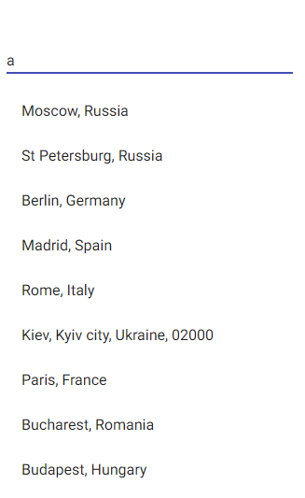

Polymer
Notes:
If all went well you should be able to see an input control with a list of cities appearing as you type..

Slide 18
Polymer
components/main-template.html
<dom-module id="main-template">
<template>
</template>
<script>
class MainTemplate extends Polymer.Element {
static get is() { return "main-template"; }
}
customElements.define(MainTemplate.is, MainTemplate);
</script>
</dom-module>
Notes:
Now we have our menu we need to make it do something useful.
We're going to start by creating a root component for our app “main-template”.
Don't forget to update the site's index.html !

Slide 19
Polymer
Import form
<link rel="import" href="form-component.html">
Add to DOM
<template>
<h1 class="title"> [[ city.name ]] </h1>
<form-component selected-city="{{ city }}"></form-component>
</template>
Notes:
Next we can import our form.
We will also add an h1 title in the template itself.
Both elements will use the “city” property for their data.
Note that the hyphenated property “selected-city” won't work in Javascript because of the hyphen, Polymer will transliterate this to camel case...
It is in fact the selectedCity property we created earlier.

Slide 20
Polymer
Properties
static get properties() {
return {
city: {
type: Object
}
}
};
Notes:
So we also have to add the referenced city property to the template.

Slide 21
Polymer
Properties
static get properties() {
return {
cityList: {
type: Array
},
searchString: {
type: String
},
candidateCities: {
type: Array
},
selectedCity: {
type: Object,
notify: true
}
};
}
Notes:
But if we want the property to come from the form we need to tell that component the property should “notify” changes.

Slide 22
Polymer
Making the map
Notes:
To be useful our form needs to do something, so we are going to add a Google map and have it centre on our selected city.

Slide 23
Polymer
Import map
<link rel="import" href="/bower_components/google-map/google-map.html">
Add to DOM
<google-map latitude="[[ city.lat ]]" longitude="[[ city.lng ]]" api-key=""></google-map>
Notes:
And it couldn't be easier.
Google have provided us with a map component, so we can just import it and add it straight to the DOM.
Our cities list provides lat and lng keys all you need to do is register an API key and it's done.
Changes from the form are sent up to the host template and passed back down to the map.

Slide 24
Polymer
Adding Style
Notes:
The only thing is the map won't have a height out of the box so you won't see it.
We also haven't really touched on layout, so let's look at the shared-styles component and add it to our app.

Slide 25
Polymer
components/shared-styles.html
<dom-module id="main-template">
<template>
<style>
html, body { margin: 0; padding: 0; }
form-component {
...
}
</style>
</template>
</dom-module>
Notes:
Shared style modules are components with no DOM or script, a style tag surrounds CSS.

Slide 26
Polymer
Use shared styles in document
<link rel="import" href="components/shared-styles.html">
<custom-style>
<style include="shared-styles">
/* Other styles in here */
</style>
</custom-style>
Notes:
Shared style components can be used at document level
Just import the component and add custom-style tag and an HTML style tag with include property.
You can add your own CSS within the style tag but it's recommended to keep things in one place.

Slide 27
Polymer
Use shared styles in components
<link rel="import" href="components/shared-styles.html">
<dom-module id="main-template">
<template>
<style include="shared-styles">
:host {
display: block;
padding: 100px 0;
};
</style>
Notes:
Shared styles are using in components simply by importing the file and adding the include property.

Slide 28
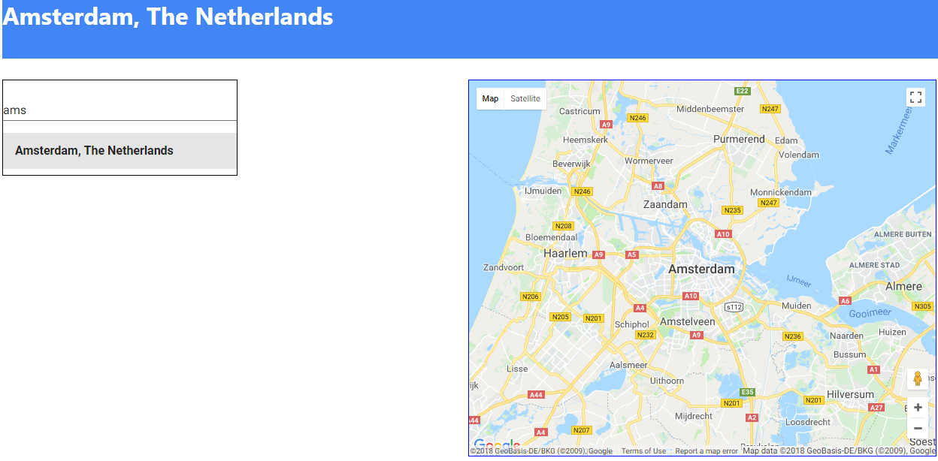
Polymer
Notes:
And that's Polymer.
- component creation & registration
- data-binding flows
- 3rd party components
- shared styles

